Slide 1
01
Book_My_Ride
Taxi and bike BOOKING SERVICES

Slide 2

1
Ritik Wandale
2
Shyam Sunder Tiwari
3
Vanshika Dhar
4
Mehak Chib
5
Hishita Thakkar

Slide 3


Contents
Introduction
Feature and services provided
Overview

Slide 4

Introduction
There was a time when we used to wave our hands to get into a cab or any public vehicle. It was the most frustrating and embarrassing moment for every one of us. But smartphones and the Internet have somehow revolutionized the work and made it easy for anyone to get a cab at their location.
The online cab booking apps have transformed the fleet industry as it is one of the best technological advancements that great ideas and vision have offered.

Slide 5
Features
The online ride-hailing market is expected to grow at a CAGR of 10.08% during the period 2020-2025.
The online cab booking trend is emerging in a futuristic landscape of shared mobility as it offers quick, simple, and affordable transportation facilities to users. Ridesharing app owners connect the driver and rider in real-time through a dedicated app solution. Users can also view the price before confirming the trip. This feature is making online taxi apps popular across the globe
13:21

Slide 6
Overview

Slide 7
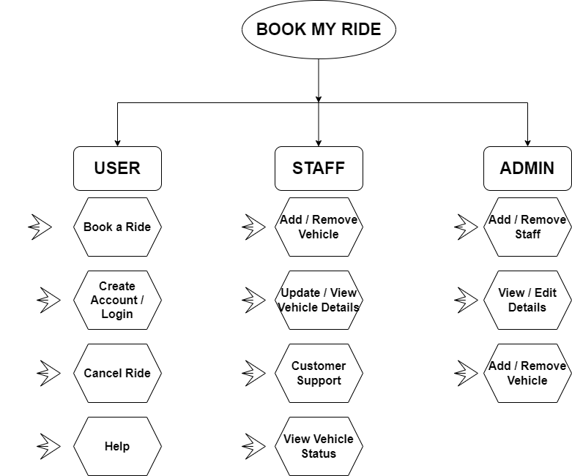

Slide 8

Thank you.

